Slide 2
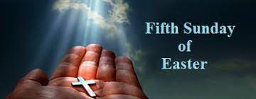

Slide 4
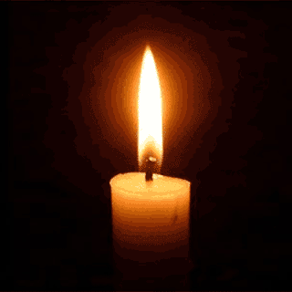
Lighting the Christ Candle

Slide 6
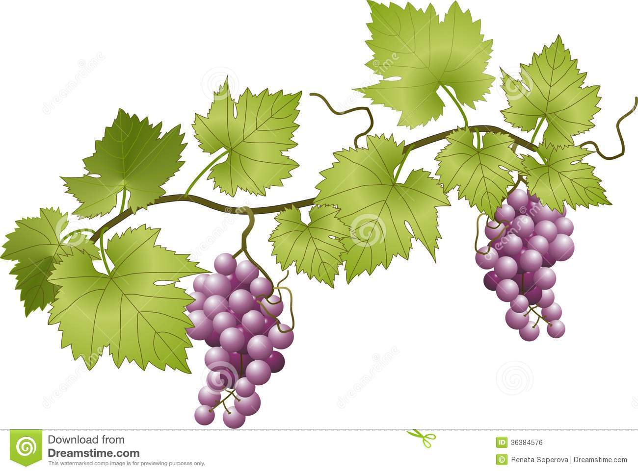
The Lord be with you
And Also With You

Slide 7
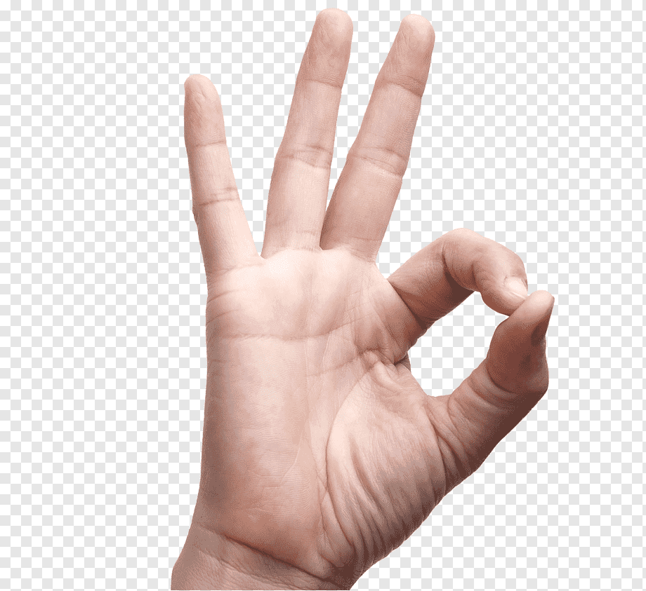
Sign of Peace

Slide 9
23 You who fear the LORD, praise Him! All you descendants of Jacob, honour him! Revere Him, all you descendants of Israel!
24 For He has not despised or disdained the suffering of the afflicted one; He has not hidden His face from him but has listened to his cry for help.

Slide 10
25 From You comes the theme of my praise
in the great assembly; before those who fear You will I fulfill my vows.
26 The poor will eat and be satisfied; those who seek the LORD will praise Him— may your hearts live forever!

Slide 11
27 All the ends of the earth will remember
and turn to the LORD, and all the families of the nations will bow down before Him,
28 for dominion belongs to the LORD and He rules over the nations.

Slide 12
29 All the rich of the earth will feast and worship; all who go down to the dust
will kneel before him— those who cannot keep themselves alive.
30 Posterity will serve Him; future generations
will be told about the Lord.

Slide 13
31 They will proclaim His righteousness to a people yet unborn— for He has done it.
Amen.

Slide 15
Joyful, joyful we adore You,
God of glory, God of love;
Hearts unfold like flowers before You
Opening to the sun above.
1/6

Slide 16
Melt the clouds of sin and sadness
Drive the dark of doubt away;
Giver of immortal gladness,
Fill us with the light of day.
2/6

Slide 17
All Your works with joy surround You,
Earth and heav’n reflect Your rays
Stars and angels sing around You,
Centre of unbroken praise.
3/6

Slide 18
Field and forest, vale and mountain,
Flowery meadow, flashing sea.
Singing bird and flowing fountain
Call to praise You joyfully.
4/6

Slide 19
You are giving and forgiving,
Ever blessing, ever blest,
Well spring of the joy of living,
Ocean-depth of happy rest.
5/6

Slide 20
You our Father, Christ our brother
All are Yours who live in love;
Teach us how to love each other,
Lift us to Your joy above.
6/6
Adapted from Ludwig van Beethoven 1770-1827

Slide 23
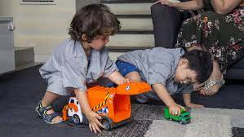

Slide 24
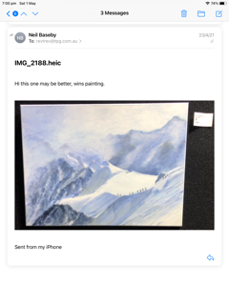
Painting by Win Baseby, entered in
Royal Easter Show, and was sold !!

Slide 25
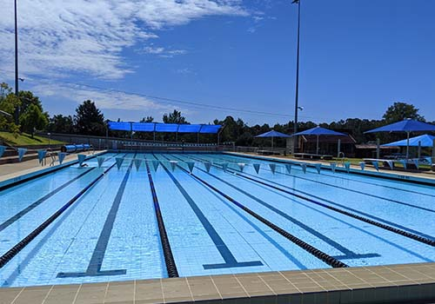
The water in the next lane is just as wet as your lane.

Slide 26
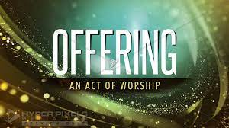

Slide 28
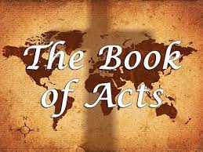

Slide 29
Philip and the Ethiopian
²⁶ Now an angel of the Lord said to Philip,
“Go south to the road—the desert road—that goes down from Jerusalem to Gaza.”
²⁷ So he started out, and on his way, he met an Ethiopian eunuch, an important official in charge
of all the treasury of the Kandake (which means
“queen of the Ethiopians”).
This man had gone to Jerusalem to worship,
²⁸ and on his way home, was sitting in his chariot reading the Book of Isaiah the prophet.

Slide 30
²⁹ The Spirit told Philip,
“Go to that chariot and stay near it.”
³⁰ Then Philip ran up to the chariot and heard the man reading Isaiah the prophet.
“Do you understand what you are reading?”
Philip asked.
³¹ “How can I,” he said, “unless someone explains it to me?” So, he invited Philip to come up and sit with him.

Slide 31
³² This is the passage of Scripture the eunuch was reading:
“He was led like a sheep to the slaughter, and as a lamb before its shearer is silent, so, he did not open his mouth. ³³ In his humiliation he was deprived of justice. Who can speak of his descendants? For his life was taken from the earth.”
³⁴ The eunuch asked Philip, “Tell me, please, who is the prophet talking about, himself or someone else?”

Slide 32
³⁵ Then Philip began with that very passage of Scripture and told him the good news about Jesus.
³⁶ As they travelled along the road, they came to some water and the eunuch said,
“Look, here is water. What can stand in the way of my being baptized?” ^{[37]}
³⁸ And he gave orders to stop the chariot.
Then both Philip and the eunuch went down into the water and Philip baptized him.

Slide 33
³⁹ When they came up out of the water, the Spirit of the Lord suddenly took Philip away, and the eunuch did not see him again, but went on his way rejoicing.
⁴⁰ Philip, however, appeared at Azotus and travelled about, preaching the gospel in all the towns until he reached Caesarea.

Slide 34
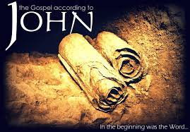

Slide 35
15 “I am the true vine, and my Father is the gardener.
² He cuts off every branch in me that bears no fruit, while every branch that does bear fruit, he prunes so that it will be even more fruitful.
³ You are already clean because of the word I have spoken to you.
⁴ Remain in me, as I also remain in you.
No branch can bear fruit by itself; it must remain in the vine. Neither can you bear fruit unless you remain in me.

Slide 36
⁵ “I am the vine; you are the branches. If you remain in me and I in you, you will bear much fruit;
apart from me you can do nothing.
⁶ If you do not remain in me, you are like a branch that is thrown away and withers; such branches are picked up, thrown into the fire and burned.
⁷ If you remain in me and my words remain in you, ask whatever you wish, and it will be done for you.
⁸ This is to my Father’s glory, that you bear much fruit, showing yourselves to be my disciples.

Slide 38
There’s a wideness in God’s mercy
Like the wideness of the sea,
And forgiveness in His justice
Sealed for us on Calvary.
1/5

Slide 39
There is plentiful redemption
In the blood that has been shed:
There is joy for all the members
In the sorrows of the Head.
2/5

Slide 40
For the love of God is broader
Than the measures of man’s mind;
And the heart of the Eternal
Is most wonderfully kind.
3/5

Slide 41
But we make His love too narrow
By false limits of our own,
And we magnify His strictness
With a zeal He will not own.
4/5

Slide 42
If our love were but more simple
We should take Him at His word;
And our lives would be illumined
By the goodness of our Lord.
5/5
John Stainer 1840-1901
Frederick William Faber 1814-63

Slide 44
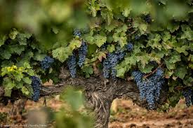

Slide 45
The vine imagery is familiar. The O T frequently pictures Israel as a vine or vineyard, but typically these references are negative. God said, “I… planted you a noble vine, wholly a right seed. How then have you turned into the degenerate branches of a foreign vine to me?” (Jer 2:21; Isa 5:7; Ezek 15:6; 19:10, 12).
Israel was the vine and was subject to judgment. Jn 15, Jesus is the vine, and it is the branches (the disciples or Israel) who are subject to judgment.
People pass vineyards walking from place to place. Some own their own vineyard or work in a vineyard. They are able to discern fruitful branches from those that will drain the vine’s energy. They trim unfruitful branches,
all the while feeling good about the surgical purpose of their work.
The pruning might seem cruel, but it renews the vine’s vitality.
Useless vines drain the plant’s strength. To leave them in place serves no purpose and reduces the value of the vineyard. The vine-grower cuts away unfruitful branches and, finding them unusable, burns them.

Slide 46
• “I am the bread of life” (6:35). • “I am the living bread that came down from heaven” (6:51). • “I am the light of the world” (8:12). • “I am the sheep’s door” (10:7). • “I am the good shepherd” (10:11). • “I am the resurrection and the life” (11:25). • “I am the way, and the truth, and the life” (14:6).
“I AM WHO I AM,” telling Moses, “You shall tell the children of Israel this: ‘I AM has sent me to you'” (Exodus 3:14)
Like the other “I am” metaphors (bread, light, gate, shepherd, etc.), the vine metaphor is reassuring comforting.

Slide 47
15 “I AM, reminds us of Moses and the Egyptian exodus, the true vine, Jesus, and my Father, God, is the gardener. a tender moment between Jesus and God.
² HE cuts off, a “God prune”, every branch is this Israel or us as the new Israel? in me that bears no fruit, while every branch that does bear fruit HE prunes, there is no exemption from pruning, so that it will be even MORE fruitful.
In 10:30 “I and the father are one.” a mutuality.

Slide 48
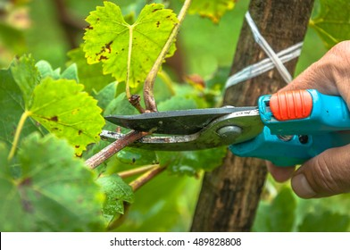

Slide 49
³ You are already clean, enough that only feet need to be washed, because of the word I have spoken to you.
⁴ Remain, tabernacle, in me, as I also remain, tabernacle, in you. John 14:2..
No branch can bear fruit by itself; it must remain in the vine. Coal in the hearth. Neither can you bear fruit unless you remain in me. Heb 10:25.

Slide 50
⁵ “I am the vine; you are the branches. IF you remain in me and I in you, YOU WILL bear much fruit; apart from me you can do nothing, less than you might otherwise, or with less impact.
⁶ IF YOU DO NOT remain in me, you are like a branch that is THROWN AWAY and withers; such branches are picked up, thrown into the fire and burned.

Slide 51
⁷ If you remain in me and my words remain in you, ask whatever you wish, and it will be done for you.
⁸ This is to my Father’s glory, that you bear much fruit, showing yourselves to be my disciples.

Slide 52
15 “I am the true vine,
and my Father is the gardener.
² He cuts off every branch in me
that bears no fruit,
while every branch that does bear fruit
he prunes so that it will be even more fruitful.
³ You are already clean because of the word
I have spoken to you.
⁴ Remain in me, as I also remain in you.
No branch can bear fruit by itself;
it must remain in the vine.
Neither can you bear fruit unless you remain in me.
⁵ “I am the vine; you are the branches.
If you remain in me and I in you,
you will bear much fruit;
apart from me you can do nothing.
⁶ If you do not remain in me,
you are like a branch that is thrown away
and withers; such branches are picked up,
thrown into the fire and burned.
⁷ If you remain in me and my words remain in you, ask whatever you wish,
and it will be done for you.
⁸ This is to my Father’s glory, that you bear much fruit, showing yourselves to be my disciples.

Slide 55
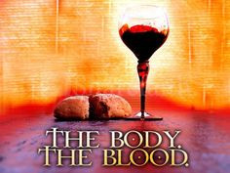
DO THIS IN REMEMBRANCE OF ME.

Slide 56
Holy, holy, holy Lord,
God of power and might,
Heaven and earth
are full of your glory.
Hosanna in the highest.

Slide 57
Blessed is He
who comes in the name of the Lord.
Hosanna in the highest.

Slide 61
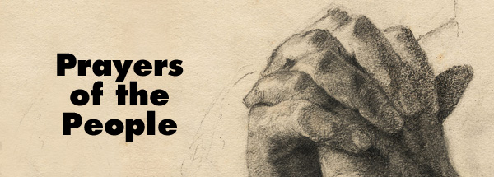

Slide 62
Our Father in heaven,
hallowed be Your name,
Your kingdom come,
Your will be done
On earth as in heaven.
Give us today our daily bread.

Slide 63
And forgive us our sins,
As we forgive those
who sin against us.
Save us from the time of trial,
And deliver us from evil.
For the kingdom, the power
and the glory are Yours,
Now and forever. Amen.

Slide 65
Thanks to God whose Word was spoken in the deed that made the earth. His the voice that called a nation; His the fires that tried her worth. God has spoken, God has spoken: praise God for His open word.
1/5

Slide 66
Thanks to God whose Word incarnate glorified the flesh of man. Deeds and words and death and rising, tell the grace in heaven’s plan. God has spoken, God has spoken: praise God for His open word.
2/5

Slide 67
Thanks to God whose word was written in the Bible's sacred page, record of the revelation showing God to every age. God has spoken, God has spoken: praise God for His open word.
3/5

Slide 68
Thanks to God whose word is published in the tongues of every race. See its glory undiminished by the change of time and place. God has spoken, God has spoken: praise God for His open word.
4/5

Slide 69
Thanks to God whose Word is answered by the Spirit's voice within. Here we drink of joy unmeasured, life redeemed from death and sin. God is speaking, God is speaking: praise God for His open word.
5/5

Slide 71
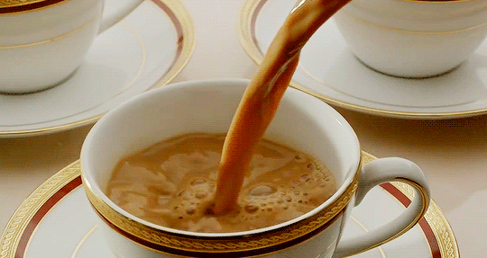
Good morning,
have a great week

Slide 72
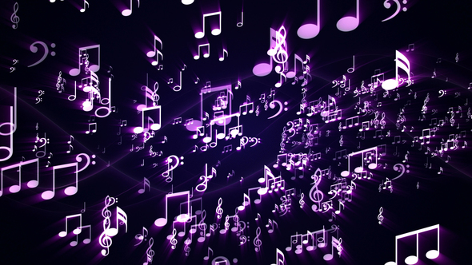
Postlude

